Slide 1

Terraform at Scale

Slide 2

Agenda
Introduction
Scaling Terraform – Out of the Box
Terragrunt
CDKTF

Slide 3
Introduction
Presenter: Jacob Charles
Founder of Bison Cloud Solutions
Other Affiliations: City County CISO, KBR
Company: Bison Cloud Solutions
Value-add managed service provider, cloud and security engineering
FedRAMP, SOC2, and cyber risk insurance compliant environments
Consulting & Engineering Services
Presentation: https://github.com/bisoncloudsolutions/terraform-at-scale

Slide 4
Scaling Terraform – Out of the Box
What does scaling Terraform mean?
Multi-Environment (Development / Test / Production / etc.…)
Multi-Tenant (Separate departments, managed service provider, products with multiple sets of environments)
Configuration Management
Key concepts to know for scaling Terraform
State File
Provider Configuration
Variables
Modules

Slide 5
Scaling Terraform – Out of the Box
Options
Copy pasting Terraform files into environment folders
Injecting all the variables and configurations through the CLI and .tfvars
Using modules
Terraform Workspaces
Cons
Configuration management had to many manual steps
Often violated best practices such as the DRY principle
Continuous integration/deployments inconsistent

Slide 6
Terragrunt
Terraform wrapper enabling DRY (Don’t Repeat Yourself) principle
Remote state configuration is DRY
CLI Flags are DRY
Ability to run multiple modules at once
Multiple AWS Accounts / Azure Subscriptions
https://terragrunt.gruntwork.io/

Slide 7
Terragrunt
Successful Terragrunt Projects
Contain Terraform code and Terragrunt configuration in the same repository
Exception when importing common modules – See Demo
Split out common modules in separate repositories
Have “core” infrastructure in the same module/repository
Terraform code/modules are contained in “application” folders, not resources
Resource based separation creates a large spiderweb of dependencies
CI/CD
Branches should be synced, do not setup branches in a way they can’t merge
Apply-all vs single module focused (Lean towards running all modules, there may be exceptions)
Utilize tagging and versioning

Slide 8
Terragrunt Demo!
Source code is in the github link
https://github.com/bisoncloudsolutions/terraform-at-scale

Slide 9
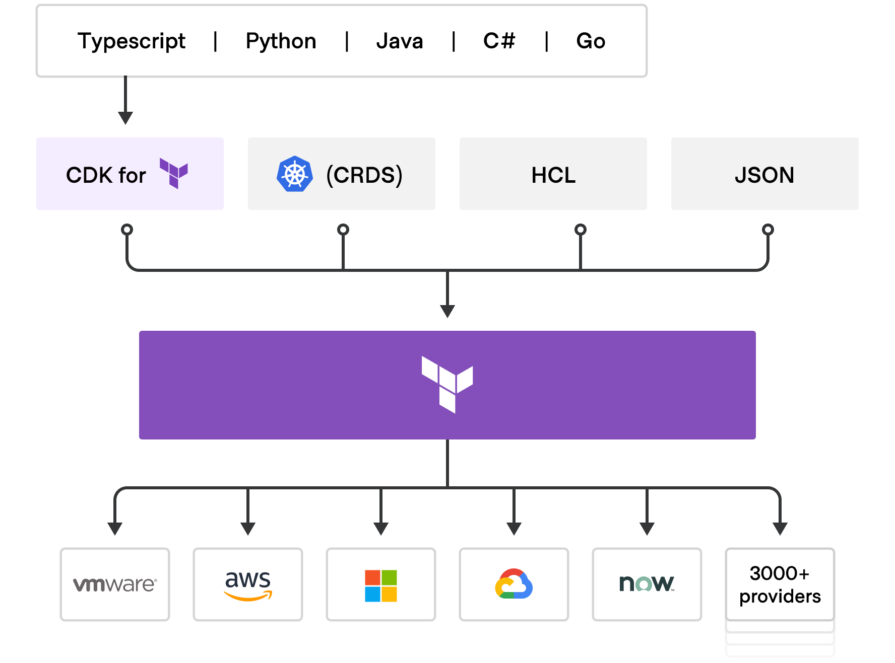
CDKTF
https://developer.hashicorp.com/terraform/cdktf

Slide 10
CDKTF
Pros
Ability to leverage a familiar programming language
High level of abstraction and ability to use more software best practices
Cons
Very young project with features from standard Terraform yet to be implemented
Heavier learning curve especially for people from an operations background (System admins, network engineers, etc…)
Template to get started on scaling
https://github.com/bisoncloudsolutions/cdktf-template
Config.py is a helper to configure stacks by environment

Slide 11
Future Considerations
Terraform Cloud or Enterprise
Paid for version is rapidly gaining features
Features shine in the automation or CI/CD aspect
Watch for CDKTF to mature

Slide 12
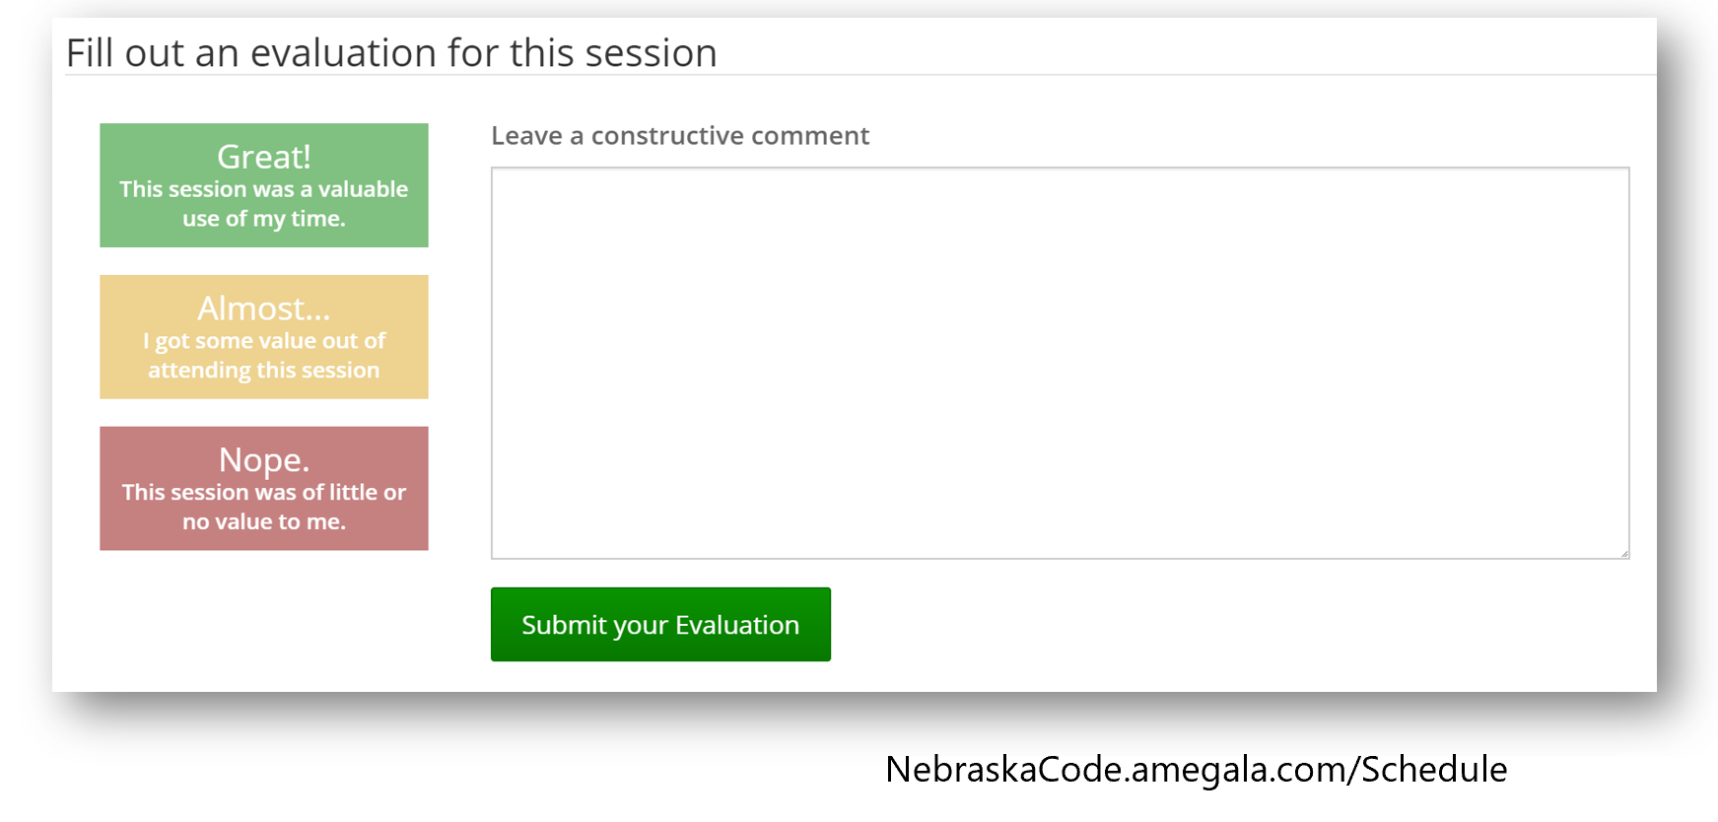
Questions?
jacob.charles@bisoncloudsolutions.com
https://bisoncloudsolutions.com
https://www.linkedin.com/in/jacobcharles300/

